Slide 1
ElectroLaser
Ale Batarse, Duncan Monahan

Slide 2
Overview
History
Plan and implantation
Upsides/pros
Downsides/cons
Summary
References

Slide 3
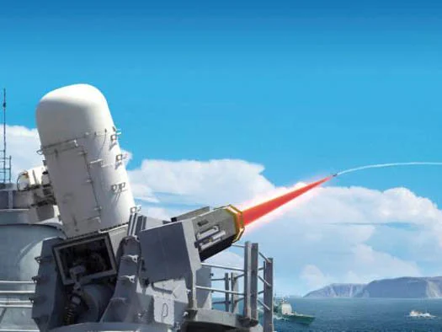
History
It was first developed and tested by the U.s Navy.
Notes:
Phoenix
It was developed and tested by the U.S Navy in 1985. This device was known as “The Phoenix Project” within the Strategic Defense Initiative research program.

Slide 4
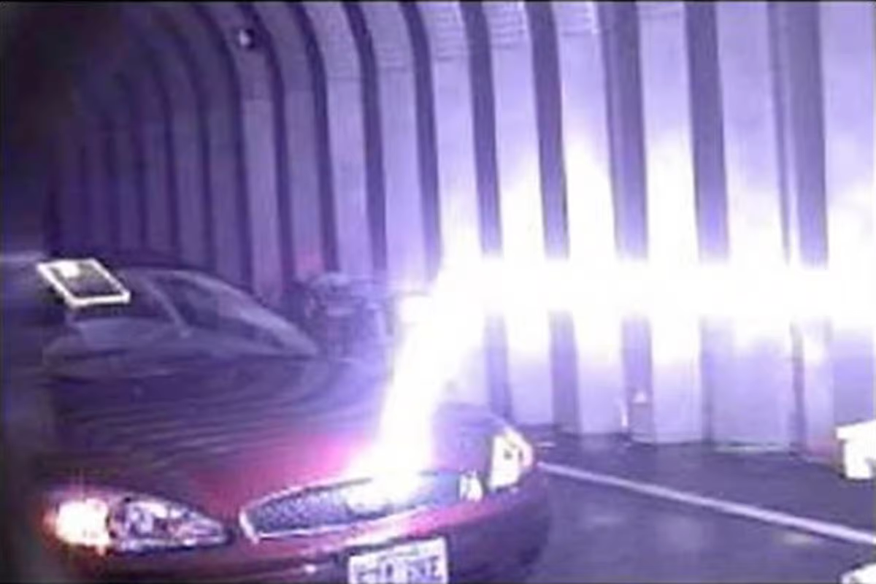
Plasma Channels
The electro laser is used through Plasma channels.
The Plasma Channels can be used to study lightning.
Notes:
Laser-Induced Plasma Channel
The electrolaser and natural lighting both have plasma channels that conduct electric current, the plasma channels can study natural lighting among other things such as: make lighting discharge at a safe time and place similar to a lighting conductor, direct atmospheric lighting to a collection station for the purpose of electrical power generation.

Slide 5
Impact
The impact the electro laser is huge it will greatly impact knowledge on laser weapons.
Along with using it in the military for self defense against other forces.
Notes:
The Promise and Problems of Laser Weapons
We can use the electro laser in war for self defense against other forces. It uses a plasma channel to try and hit a target. With the development of the electrolaser we will learn how to use plasma channels effectively and more efficiently.

Slide 6
4
Pros/Upsides of the Electrolaser

Slide 7
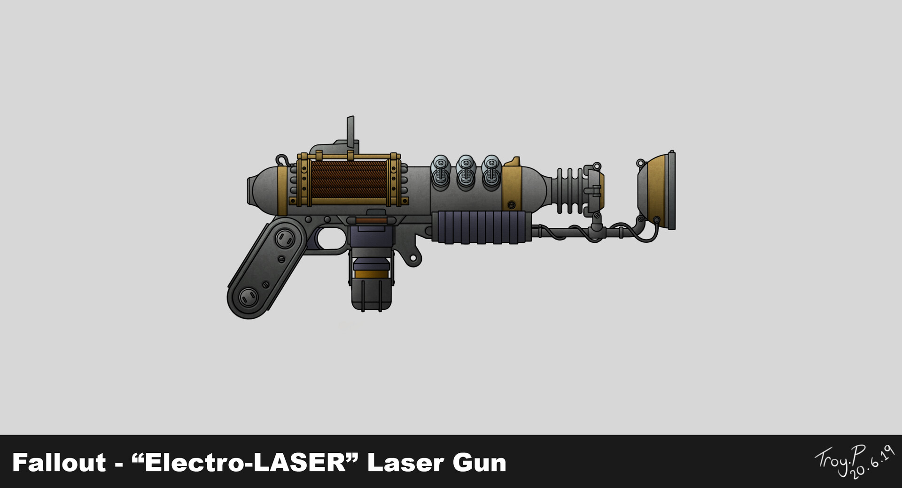
Other uses/pros
The electrolaser is mainly used to strike a target.
But also used to study lighting during a thunderstorm.
Notes:
The electrolaser is mainly used to incapacitate an elected target through electric shock, but it also has many other uses such as helping to study lighting during a thunderstorm. The electrolaser is mainly used to incapacitate an elected target through electric shock, but it also has many other uses such as helping to study lighting during a thunderstorm.

Slide 8
Downsides/Cons
7
Notes:
Some down sides of the electro laser is that it is mainly used for violence and destruction. Even if not being used to kill it may be used to discharge other electrical components in battle. It is also inconsistent and may cause lightning strikes at random places.

Slide 9
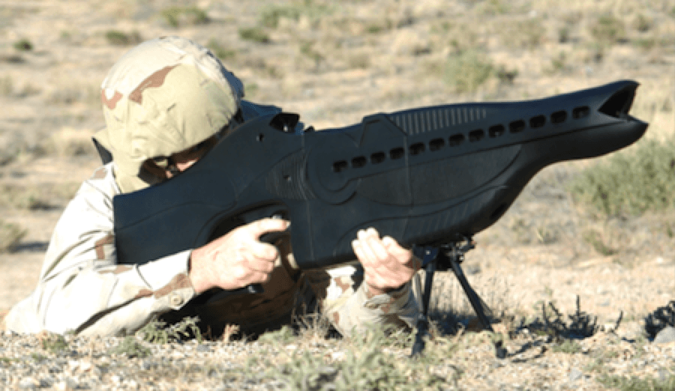
Downsides/Cons
A downside of the electro laser is it is mainly used to as a weapon.
It is inconsistent and can cause accidents.
Notes:
Uses
Some down sides of the electro laser is that it is mainly used for violence and destruction. Even if not being used to kill it may be used to discharge other electrical components in battle. It is also inconsistent and may cause lightning strikes at random places.

Slide 10
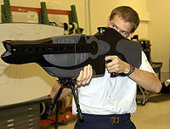
Summary
The Electro laser can be used for good but also bad.
We can use it to study lightning and other patterns.
It is inconsistent but once we learn how to use it it will be an amazing tool.
Notes:
The Electro laser can be used for good like studying for lightning and other weather patterns. We can also use it for bad in war and use it to kill people. This is also a good thing for military just I wouldn't say that is a totally positive way to use such a useful tool. While it is a inconsistent tool once we figure out how to properly use it and fix it it will be a great tool to use later on.

Slide 11
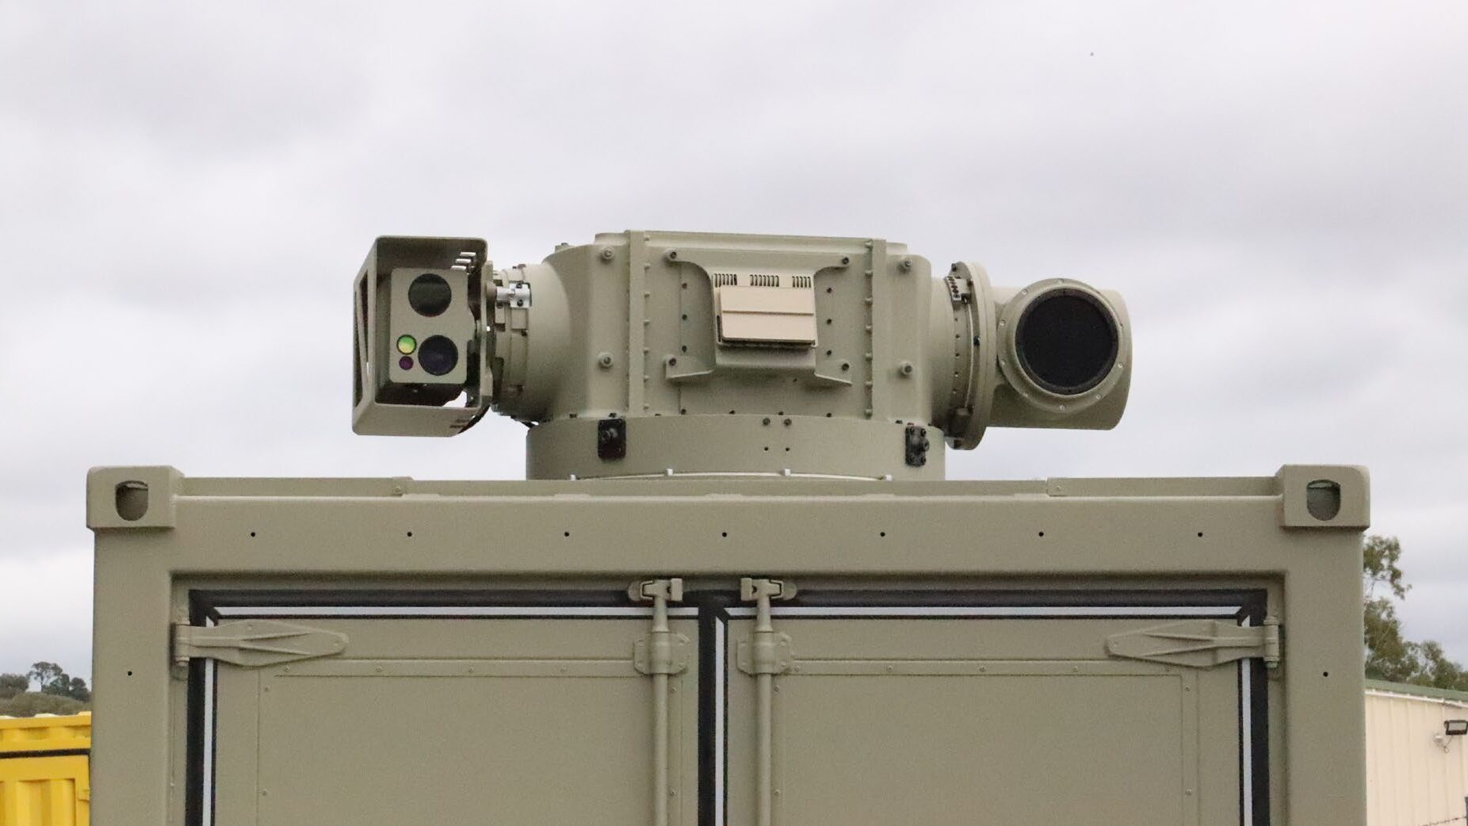
For
The Use of the electrolaser as weapon can be a positive for war.
Studies lightning
Notes:
Often times used for war and to settle conflicts is a great way to use the weapon. The study of lightning is also great use for the tool and

Slide 12
Against
You could be against this weapon because it is mainly used for violence and to kill.
It also is inconsistent and often times screws up.

